Slide 1
CS 230 Game Implementation Techniques
Week 9 Lecture
Instructor
Doug Schilling
dschilling@digipen.edu
X5066
Office Hours
Monday & Wednesday
1:00pm – 2:30pm
Line Equations
Point-Line Collision

Slide 2
Line Equations

Slide 3
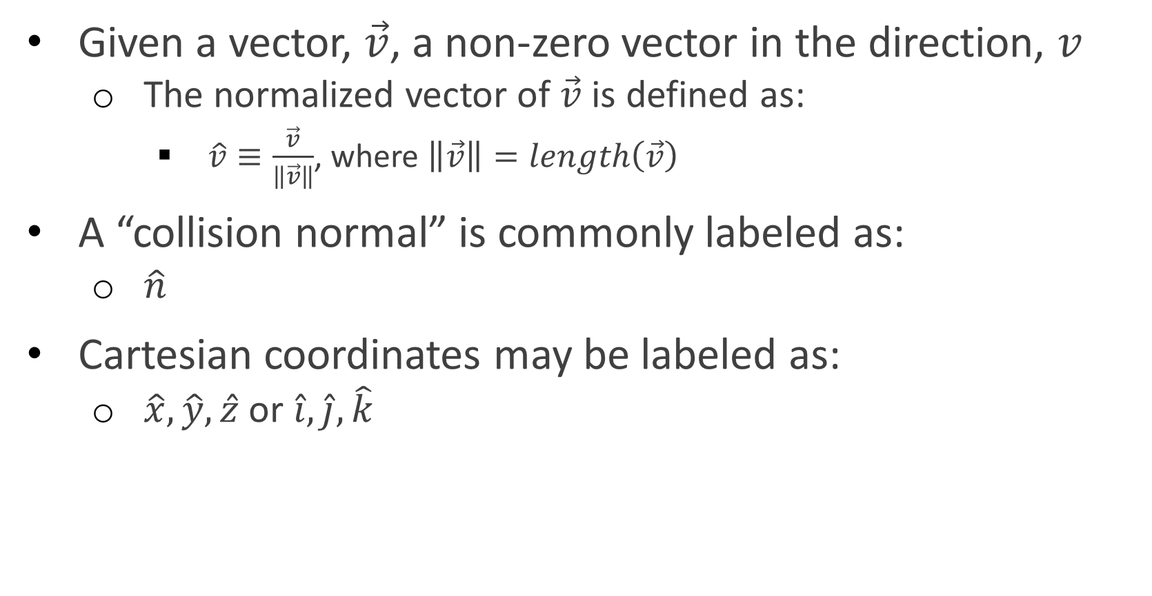
Terminology
Given a vector, $\vec{v}$, a non-zero vector in the direction, $v$
The normalized vector of $\vec{v}$ is defined as:
$\hat{v}≡\frac{\vec{v}}{\left\|\vec{v}\right\|}$, where $\left\|\vec{v}\right\|=length\left(\vec{v}\right)$
A “collision normal” is commonly labeled as:
$\hat{n}$
Cartesian coordinates may be labeled as:
$\hat{x},\hat{y},\hat{z}$ or $\hat{i},\hat{j},\hat{k}$

Slide 4
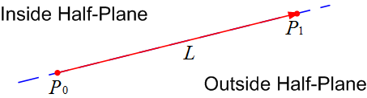
Line Segment & Half Planes
Consider a directed line segment, L, from points P₀ to P₁
An infinite extension of L divides the XY-plane into two half-planes
Half-plane on L’s right-hand side is by (our) convention referred to as outside (or, positive) half-plane
Half-plane on L’s left-hand side is inside (or, negative) half-plane

Slide 5
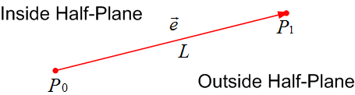
Line Segment: Edge Vector
Computing L’s edge vector

Slide 6
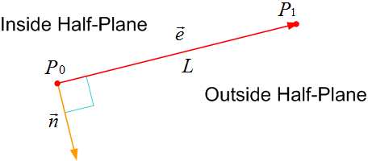

Line Segment: Outward Normal
What is the outward normal to line segment L?
Vector $\vec{n}$ is orthogonal to L’s edge vector, $\vec{e}$, such that $\vec{n}$ is oriented from L’s inside to outside half-plane

Slide 7

Line Segment: Outward Normal
How is the outward normal, $\vec{n}$, to line segment, L, computed?
Rotate the edge vector, $\vec{e}$, by −90° about the Z-axis
That is, edge vector $\vec{e}$ is rotated in the clockwise direction about Z-axis by 90° (right-hand rule)

Slide 8

Line Segment: Outward Normal
Computing the outward normal
Compute the directed line segment L’s edge vector $\vec{e}$:

Slide 9
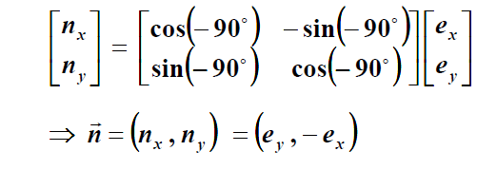
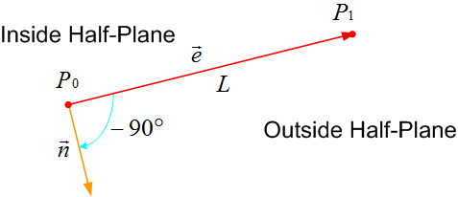

Line Segment: Outward Normal
Computing the outward normal
Rotate edge vector $\vec{e}$by −90° about the z-axis:

Slide 10
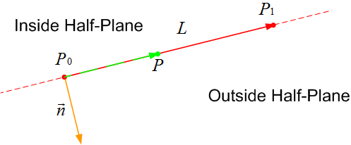

Point-Normal Line Equation
Let $P\left(x,y\right)$ be an arbitrary point on L’s infinite extension
The point-normal line equation of L is:
$L:\vec{n}∙\left(P−P_{0}\right)=0 → \vec{n}∙P−\vec{n}∙P_{0}=0$

Slide 11

Point-Normal Line Equation
It is better to use a normalized outward normal, $\hat{n}$
Recall: $\hat{n}=\frac{\vec{n}}{\left\|\vec{n}\right\|}$
Using $\hat{n}$, the point-normal equation of line segment L from point P₀ to point P₁ is written as:
$L:\hat{n}∙P−\hat{n}∙P_{0}=0$

Slide 12
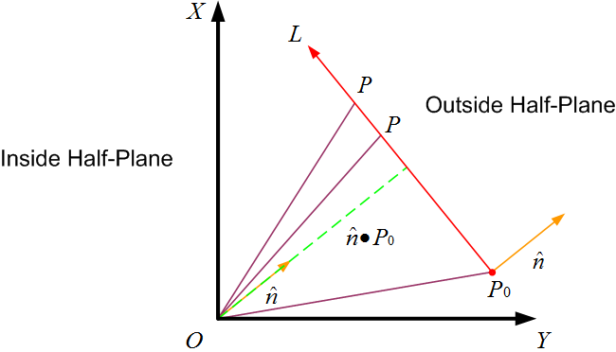

Geometrical Interpretation
Projections of position vectors of each of the infinite points P on L onto normalized outward normal $\vec{n}$ will result in the same value, $\hat{n}∙P_{0}$
$\hat{n}∙P_{0}$is orthogonal (or, shortest) distance from coordinate system origin to L

Slide 13
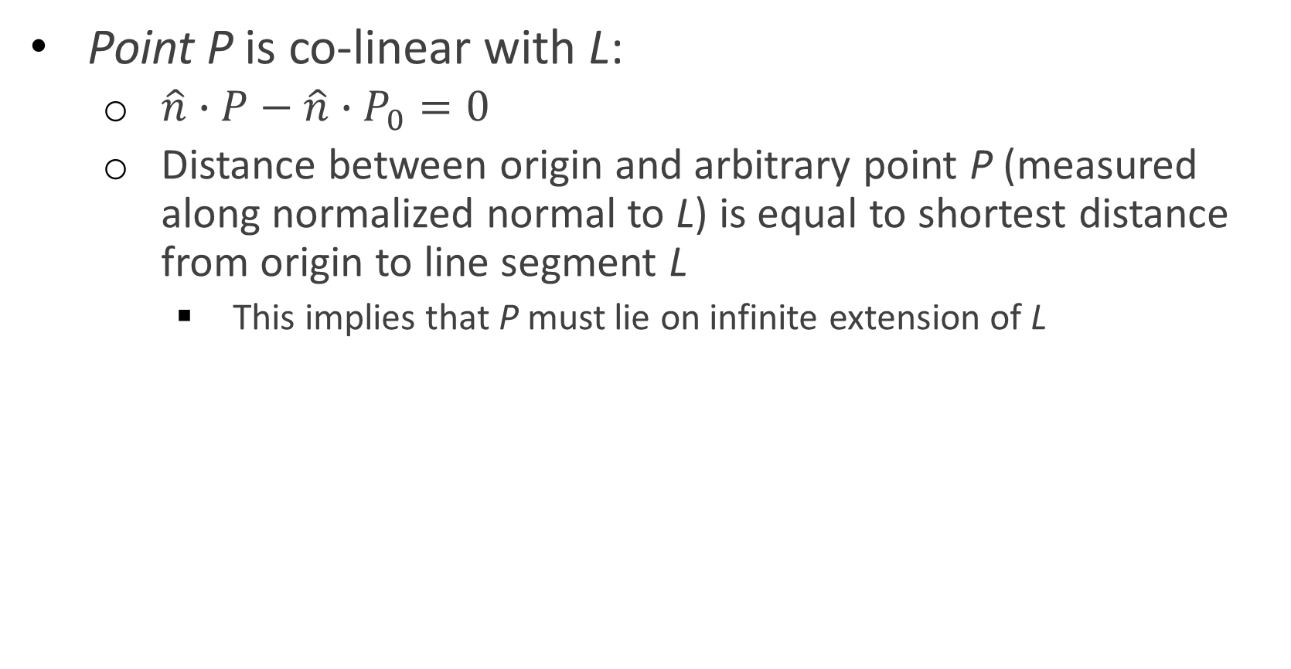
Point-Line Classification
Point P is co-linear with L:
$\hat{n}∙P−\hat{n}∙P_{0}=0$
Distance between origin and arbitrary point P (measured along normalized normal to L) is equal to shortest distance from origin to line segment L
This implies that P must lie on infinite extension of L

Slide 14
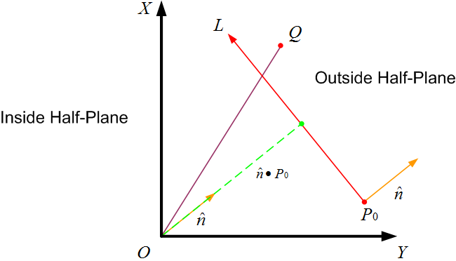
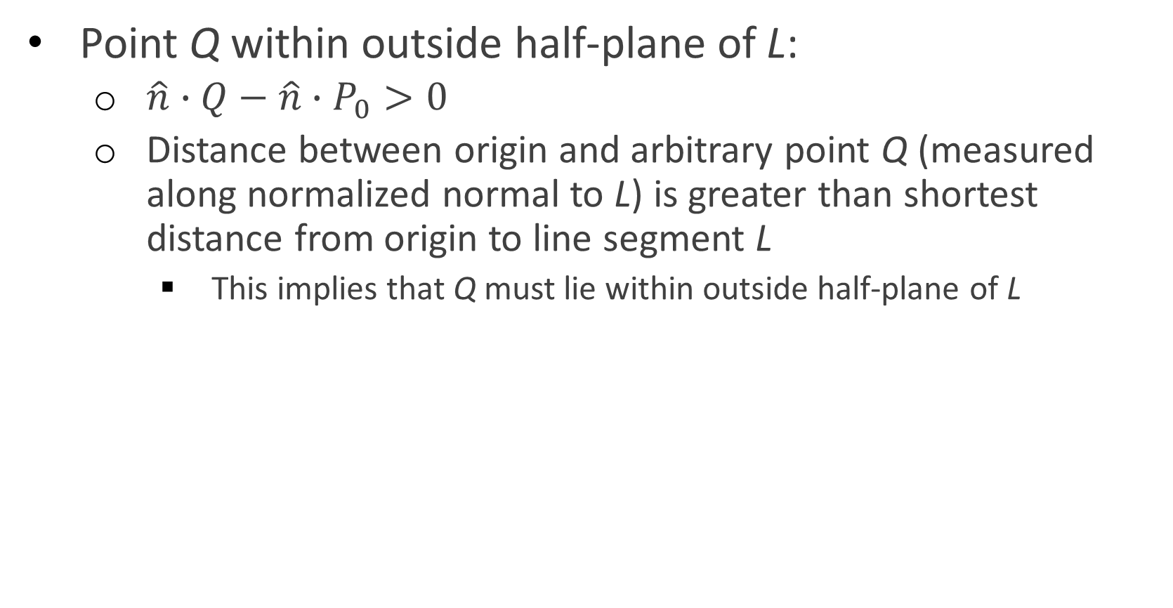
Point-Line Classification
Point Q within outside half-plane of L:
$\hat{n}∙Q−\hat{n}∙P_{0}>0$
Distance between origin and arbitrary point Q (measured along normalized normal to L) is greater than shortest distance from origin to line segment L
This implies that Q must lie within outside half-plane of L

Slide 15
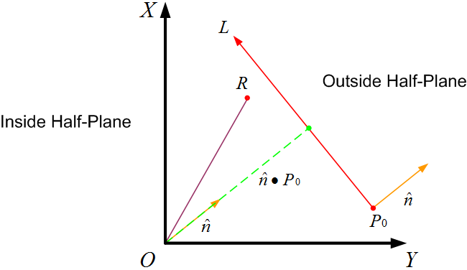

Point-Line Classification
Point R within inside half-plane of L:
$\hat{n}∙R−\hat{n}∙P_{0}<0$
Distance between origin and arbitrary point R (measured along normalized normal to L) is smaller than shortest distance from origin to line segment L
This implies that R must lie within inside half-plane of L

Slide 16
Questions?

Slide 17
Point-Line Collision

Slide 18
Collision Scenario
Given:
Static wall of finite length and infinitesimal thickness
Dynamic ball with an infinitesimal radius
Problem:
Ensure dynamic ball correctly collides and bounces off wall

Slide 19
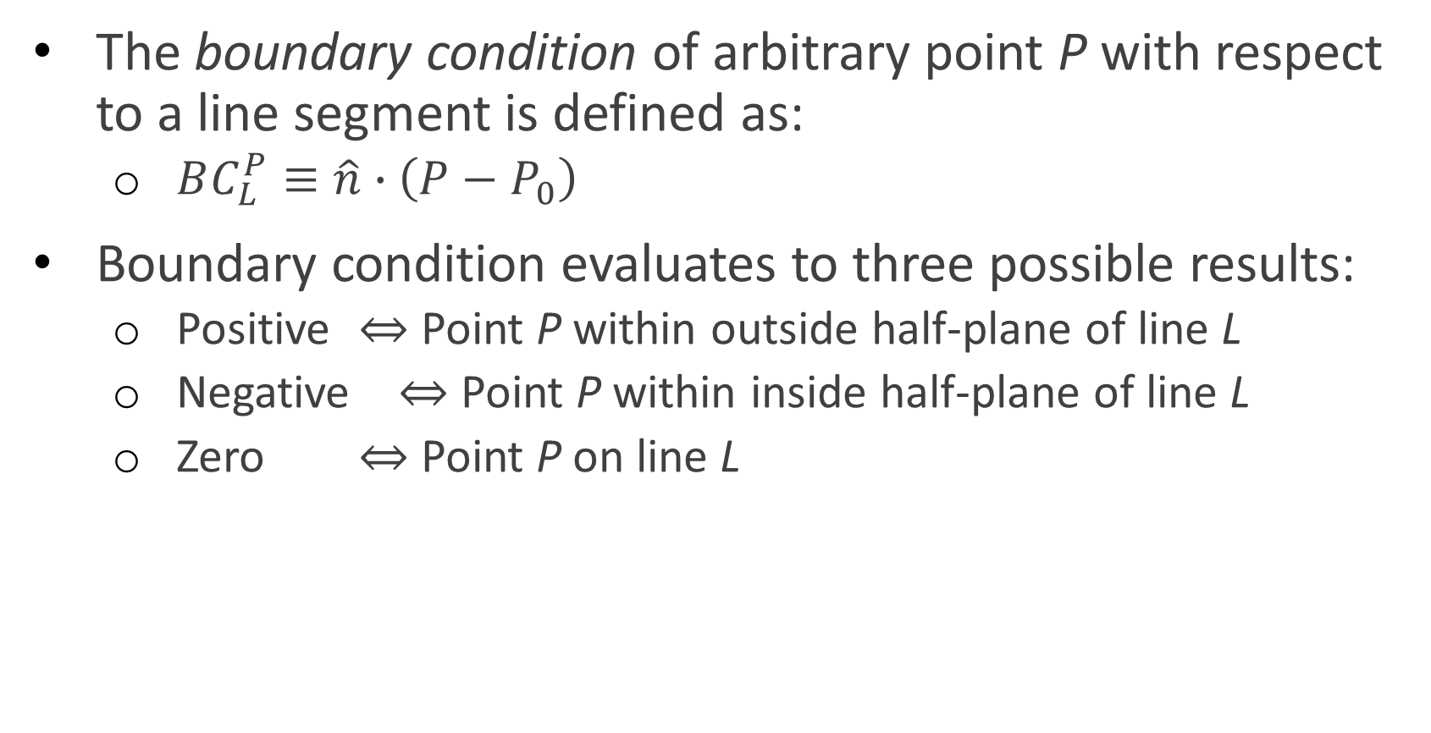
Boundary Condition of Point
The boundary condition of arbitrary point P with respect to a line segment is defined as:
$BC_{L}^{P}≡\hat{n}∙\left(P−P_{0}\right)$
Boundary condition evaluates to three possible results:
Positive ⇔ Point P within outside half-plane of line L
Negative ⇔ Point P within inside half-plane of line L
Zero ⇔ Point P on line L

Slide 20
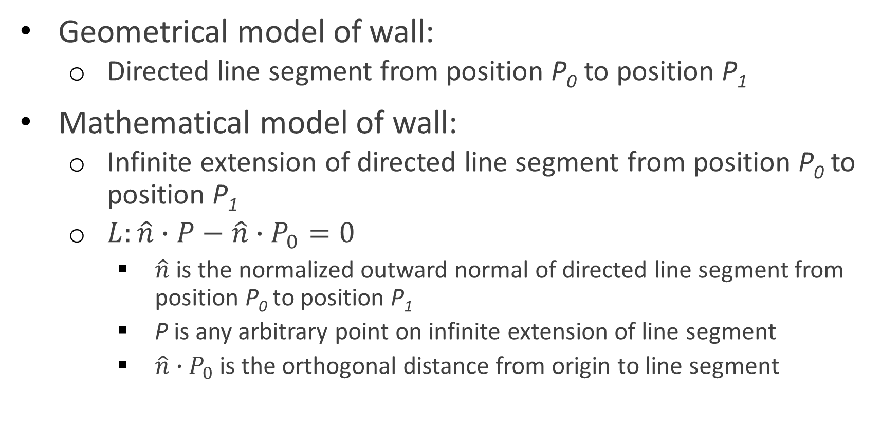
Modeling a Wall
Geometrical model of wall:
Directed line segment from position P₀ to position P₁
Mathematical model of wall:
Infinite extension of directed line segment from position P₀ to position P₁
$L:\hat{n}∙P−\hat{n}∙P_{0}=0$
$\hat{n}$ is the normalized outward normal of directed line segment from position P₀ to position P₁
P is any arbitrary point on infinite extension of line segment
$\hat{n}∙P_{0}$is the orthogonal distance from origin to line segment

Slide 21
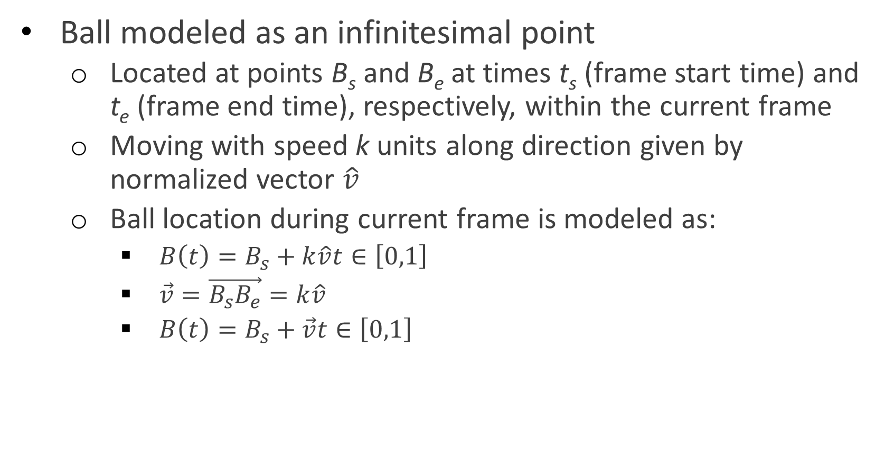
Modeling a Ball
Ball modeled as an infinitesimal point
Located at points B_{s} and B_{e} at times t_{s} (frame start time) and t_{e} (frame end time), respectively, within the current frame
Moving with speed k units along direction given by normalized vector $\hat{v}$
Ball location during current frame is modeled as:
$B\left(t\right)=B_{s}+k\hat{v}t∈\left[0,1\right]$
$\vec{v}=\vec{B_{s}B_{e}}=k\hat{v}$
$B\left(t\right)=B_{s}+\vec{v}t∈\left[0,1\right]$

Slide 22
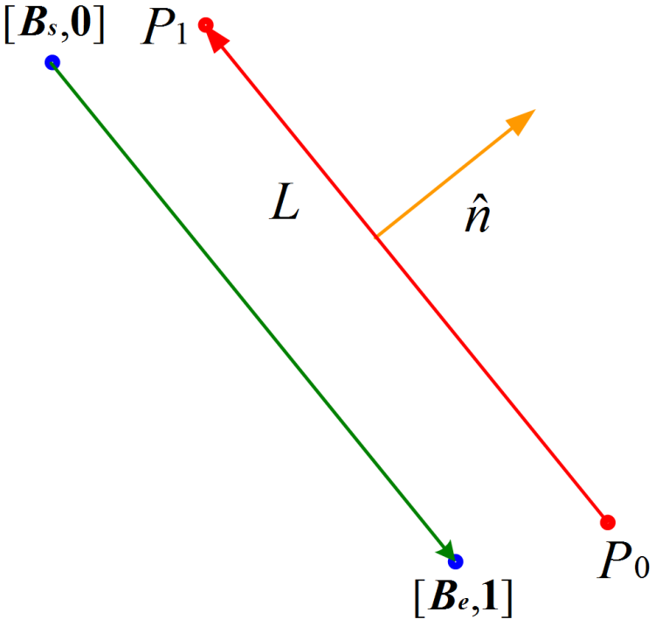


Test for Non-Collision
Ball modeled as an infinitesimal point
$B\left(t\right)=B_{s}+\vec{v}t∈\left[0,1\right]$
Wall modeled as:
$L:\hat{n}∙P−\hat{n}∙P_{0}=0$

Slide 23
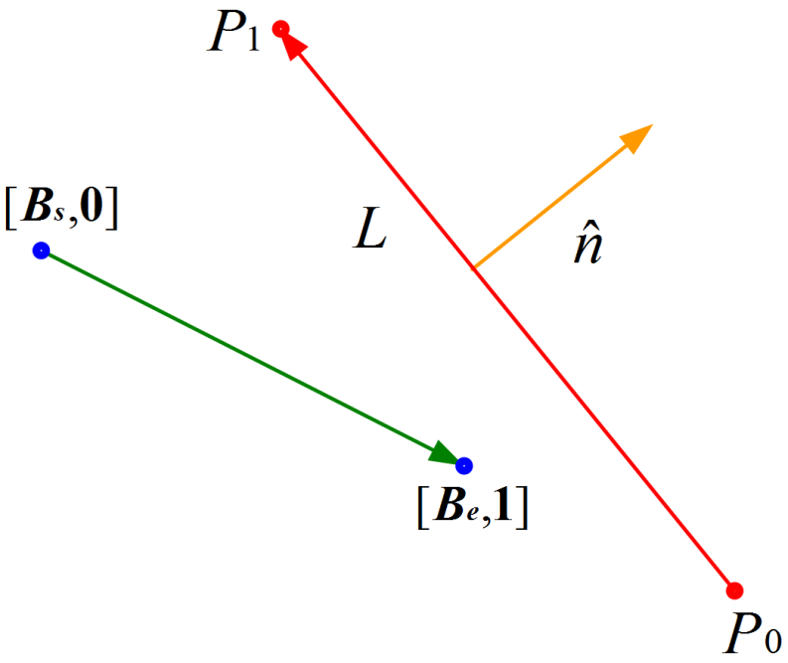
Test for Non-Collision
Ball modeled as an infinitesimal point
$B\left(t\right)=B_{s}+\vec{v}t∈\left[0,1\right]$
Wall modeled as:
$L:\hat{n}∙P−\hat{n}∙P_{0}=0$

Slide 24
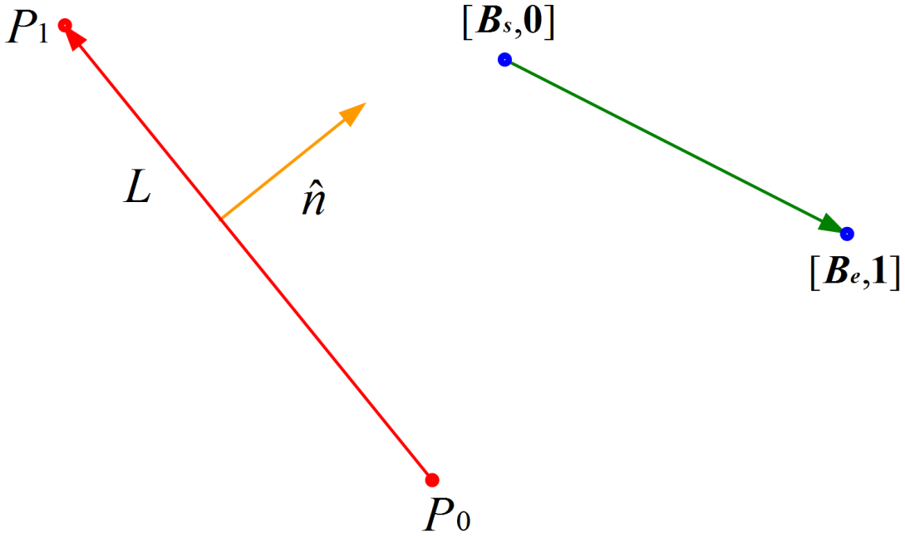
Test for Non-Collision
Ball modeled as an infinitesimal point
$B\left(t\right)=B_{s}+\vec{v}t∈\left[0,1\right]$
Wall modeled as:
$L:\hat{n}∙P−\hat{n}∙P_{0}=0$

Slide 25
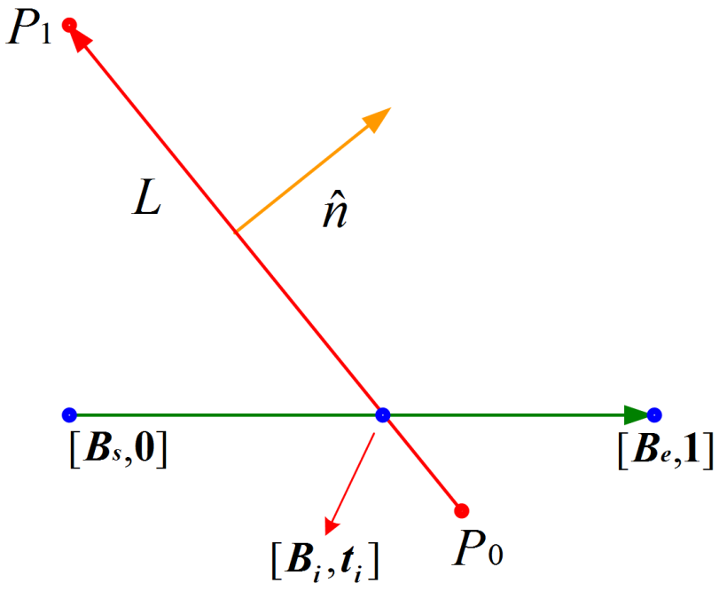
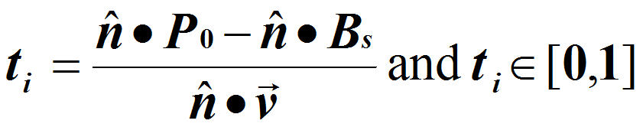
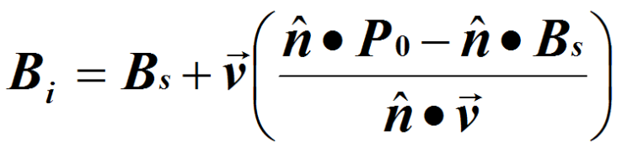
Point-Line Intersection
Ball modeled as an infinitesimal point
$B\left(t\right)=B_{s}+\vec{v}t∈\left[0,1\right]$
Wall modeled as:
$L:\hat{n}∙P−\hat{n}∙P_{0}=0$

Slide 26
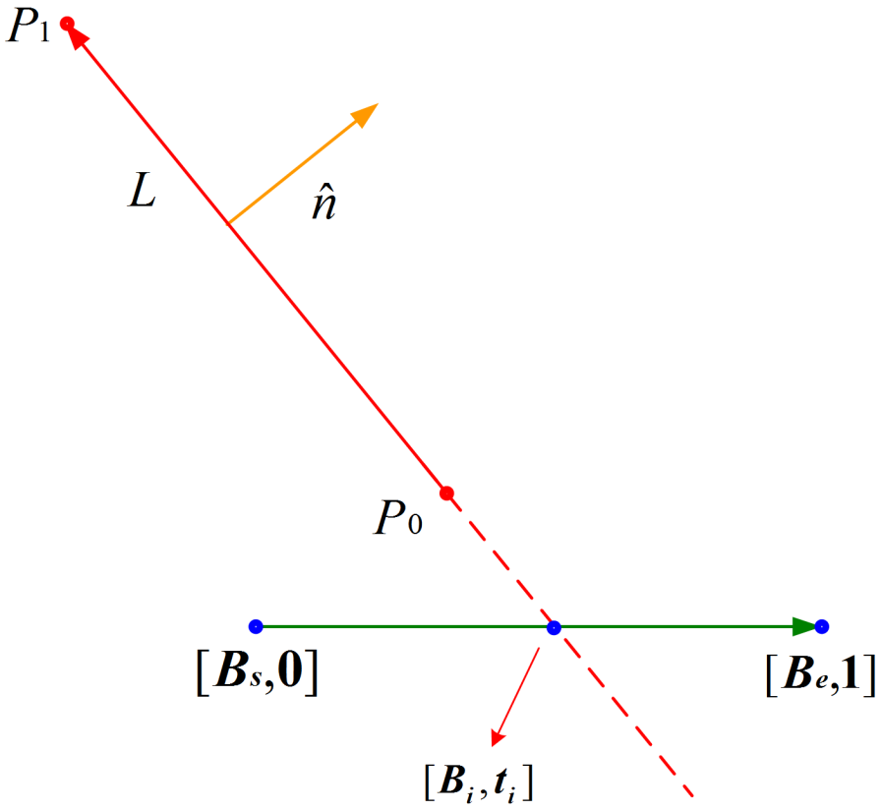

Test for Non-Collision
Ball modeled as an infinitesimal point
$B\left(t\right)=B_{s}+\vec{v}t∈\left[0,1\right]$
Wall modeled as:
$L:\hat{n}∙P−\hat{n}∙P_{0}=0$
Ball collides with infinite extension of wall … not finite wall!

Slide 27
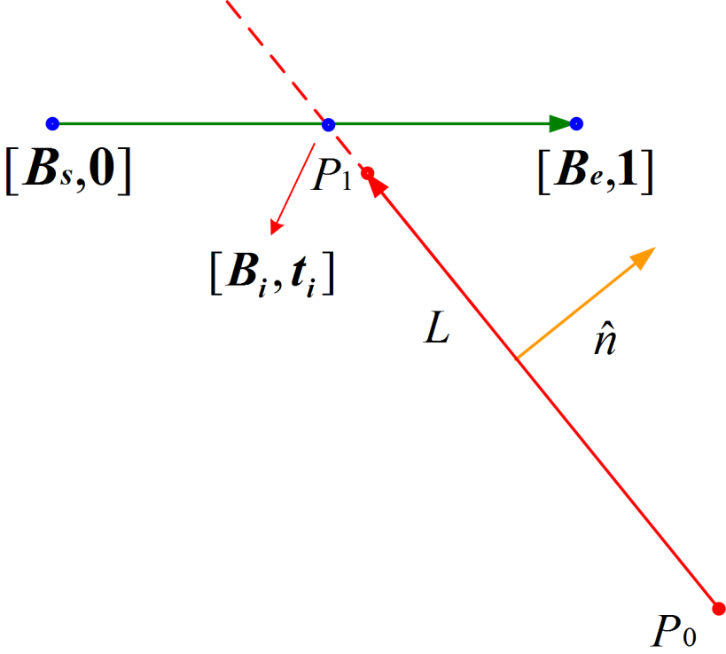

Test for Non-Collision
Ball modeled as an infinitesimal point
$B\left(t\right)=B_{s}+\vec{v}t∈\left[0,1\right]$
Wall modeled as:
$L:\hat{n}∙P−\hat{n}∙P_{0}=0$
Ball collides with infinite extension of wall … not finite wall!

Slide 28

Questions?
Ball modeled as an infinitesimal point
$B\left(t\right)=B_{s}+\vec{v}t∈\left[0,1\right]$
Wall modeled as:
$L:\hat{n}∙P−\hat{n}∙P_{0}=0$

Slide 29
References
https://en.wikipedia.org/wiki/Distance_from_a_point_to_a_line
https://en.wikipedia.org/wiki/Dot_product
https://en.wikipedia.org/wiki/Right-hand_rule
https://en.wikipedia.org/wiki/Unit_vector

